Slide 1
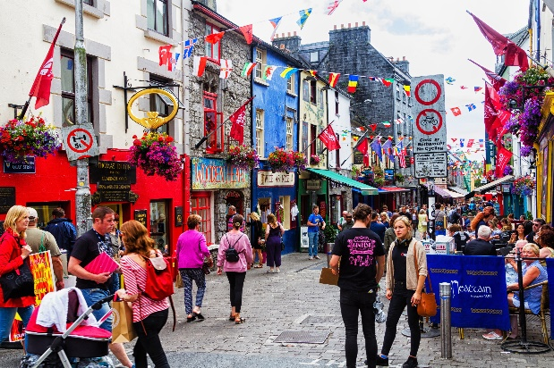
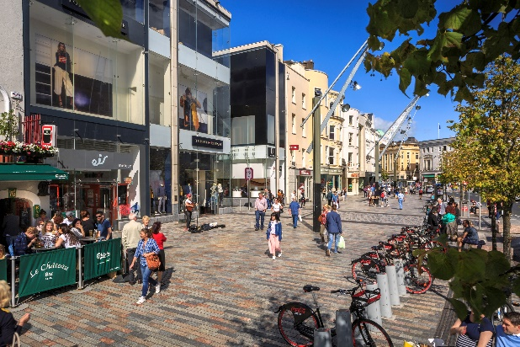
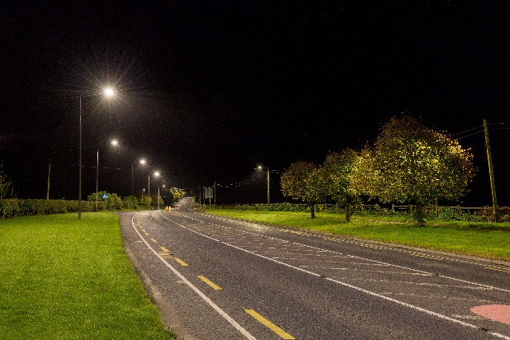
Delivering Effective Climate Action 2030
David Mellett
Regional Coordinator, CARO 14th April 2021

Slide 2
Role of local authorities
“Our local authorities occupy a pivotal role in their respective local communities and can act to demonstrate public sector leadership on climate action in their areas as well as key mobilisers of action at a local and community level”
[Climate Action Plan 2019]

Slide 3
Our strategic capabilities
Leadership
Capability
Technical delivery
Networks and community links
Empowering action
Placemaking
“Local authorities have the capability to empower communities using the wide network of community development, environmental, biodiversity, arts, heritage, green business and climate action officers.”

Slide 4
Our Strategy
Our Strategy – Delivering Effective Climate Action 2030 – provides a sectoral Vision and Mission to build on the existing expertise and skills and coordinate future work to maximise the leadership role of local authorities and impact on climate change, locally, regionally and nationally.

Slide 5
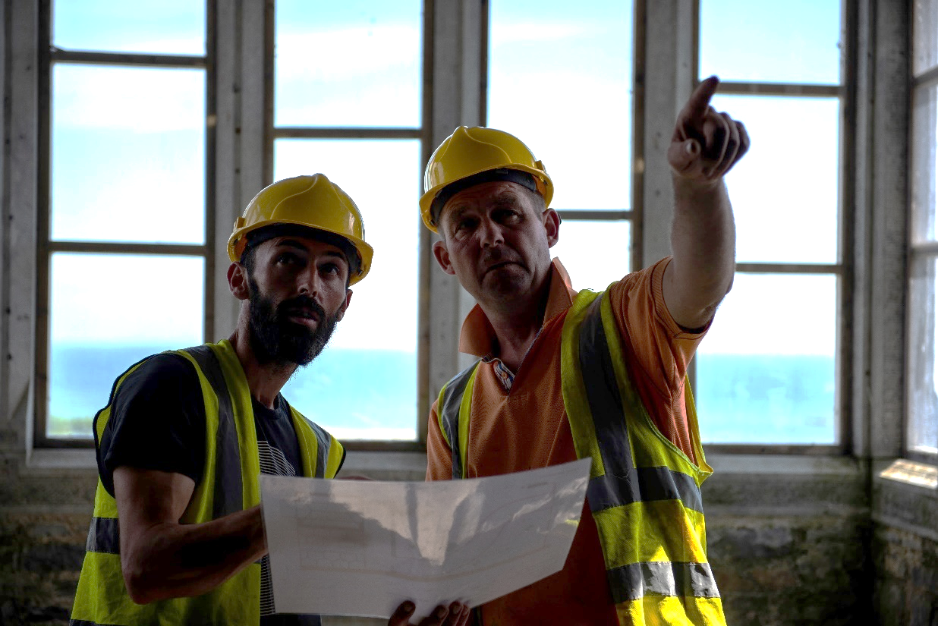
The Vision
To leverage the capability, reach and resources of local authorities to effectively lead and coordinate climate action across Ireland.
The Mission
To deliver transformative change and measurable climate action across our cities and counties and within our own organisations, through leadership, example and mobilising action at a local level.

Slide 6
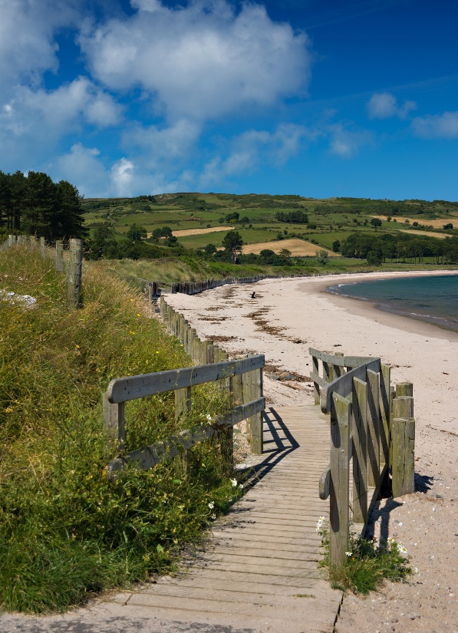
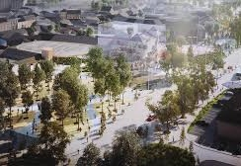
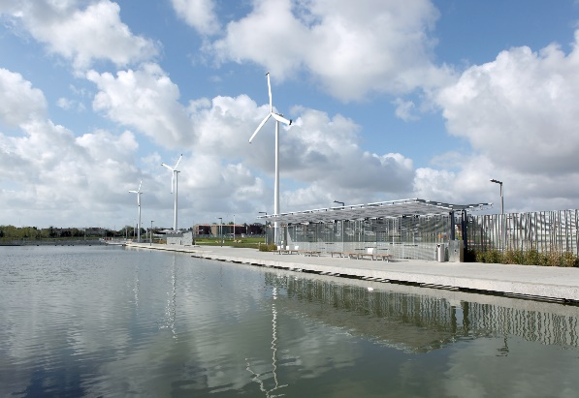
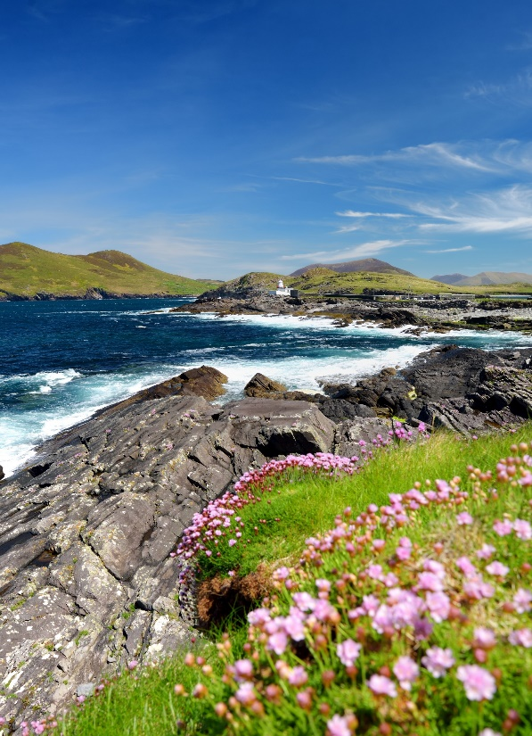

Slide 7
Strategic Goal 1
Foster governance, leadership and partnerships for climate action
Realise our key leadership role
Common purpose and approach
Embed climate action
Build internal capacity and readiness

Slide 8
Strategic Goal 2
Achieve our carbon emission and energy efficiency targets for 2030 and 2050
Leading by example
Adhere to carbon budgets
Invest in decarbonisation

Slide 9
Strategic Goal 3
Deliver on climate adaptation and climate resilience
Local authority adaptation strategies
Support other agencies
Spatial planning
Nature-based solutions
Capture the opportunities

Slide 10
Strategic Goal 4
Mobilise climate action in local communities
Engage & empower communities
Inform, motivate & support
Co-create a local vision of the future
Develop partnerships
Demonstration projects

Slide 11
Strategic Goal 5
Mobilise climate action in enterprise and support transition to an inclusive, net zero and circular economy
Embed climate action into economic development strategies and plans
Support development of low carbon and resilient enterprise development
Support emerging green business opportunities

Slide 12
Strategic Goal 6
Achieve a ‘just transition’ particularly for communities that may be economically disadvantaged by decarbonising projects
Identify vulnerable sectors & communities
Be the voice for communities
Implement measures & supports

Slide 13
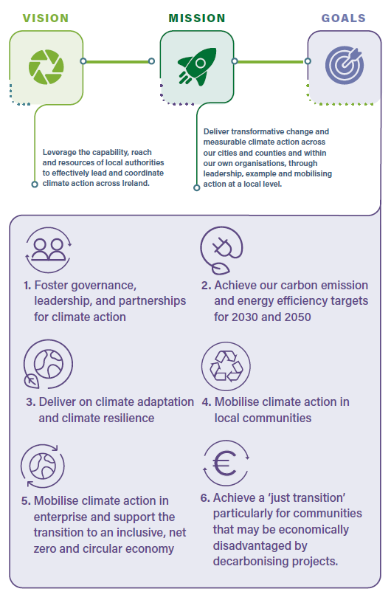
Final thoughts
Leading in the effort to tackle climate change
Meeting the ambition & commitments in the Local Authority Climate Action Charter
Common vision and mission in our collective response and readiness
Opportunity for the sector

