Slide 1
Brexit: Threats, Challenges & Opportunities
Dan O’Brien
Chief Economist
Institute of International and European Affairs

Slide 2
Contents
EU-UK trade and the UK economy
Irish economy issues
Scenarios for March 29 2018
Challenges and threats
Opportunities

Slide 3
The UK economy:
Trade and economic growth

Slide 4
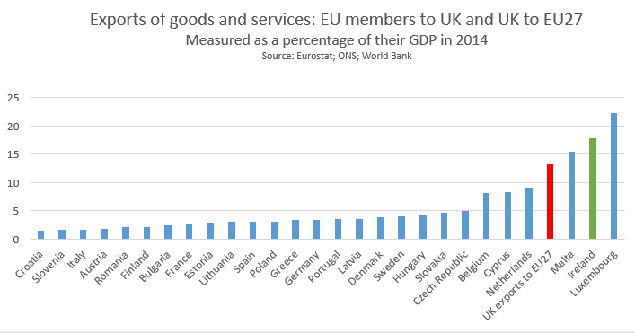
Britain’s position is fundamentally weak

Slide 5
Britain’s economy has been resilient

Slide 6
Irish economy issues

Slide 7

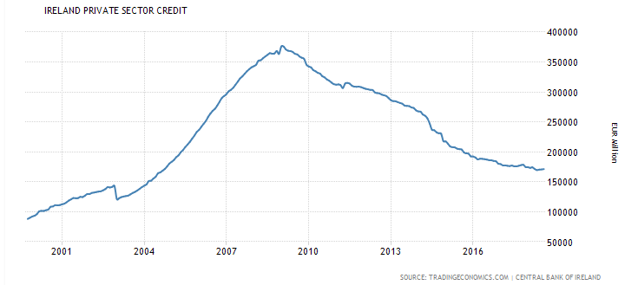
Credit is not driving the economy

Slide 8
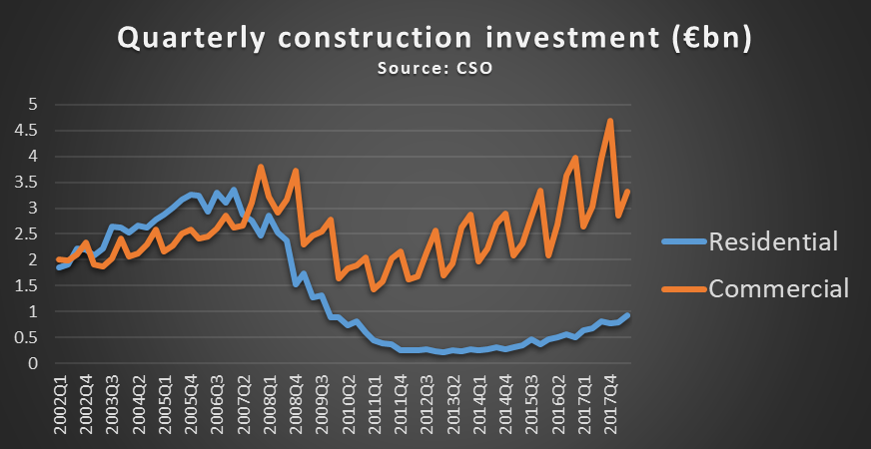
Construction: residential is still on the floor

Slide 9
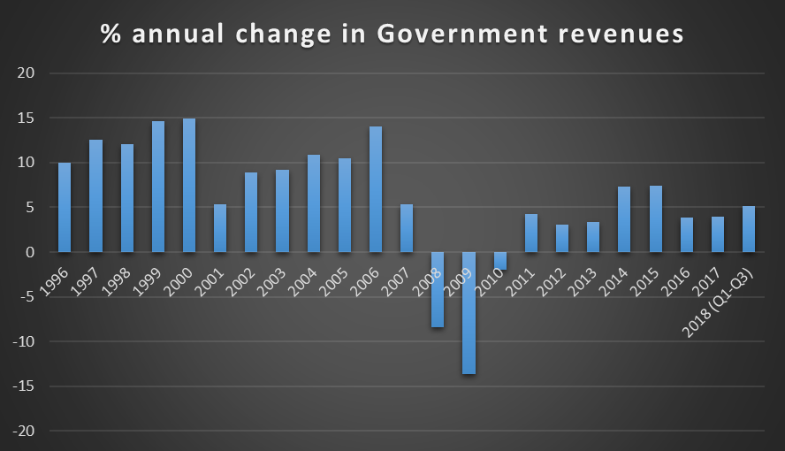
The economy is doing well, but we’re not back to pre-2008 times

Slide 10
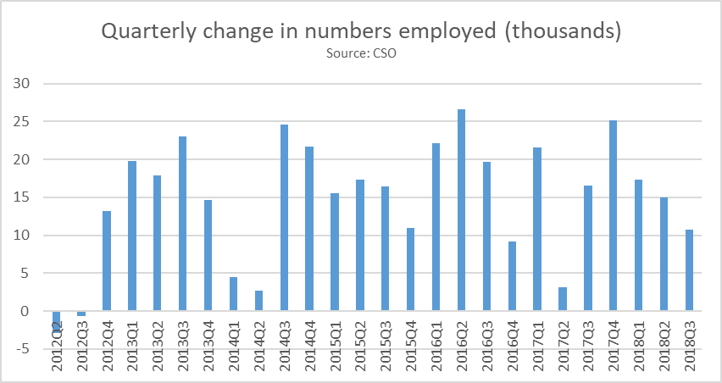
Employment growth has been strong

Slide 11
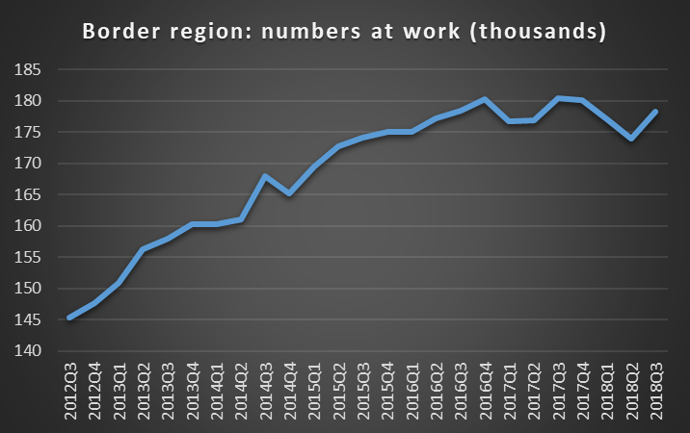
Employment is faltering in border region

Slide 12
Three major risks
Hard Brexit
US-EU trade war
Italy goes Greek

Slide 13
Brexit scenarios

Slide 14
Four scenarios for March 29 2018
No Brexit (15% probability)
A substantially different deal (2% probability)
Current draft deal (15% probability)
No deal Brexit (68pc probability)

Slide 15
Brexit implications

Slide 16
Political and geopolitical consequences
Europe/EU/UK has less global influence
EU is less transatlantic
Europe is weaker vis a vis Russia
EU is more German-centred

Slide 17
Economic and financial consequences
Europe/EU/UK has less global influence
Europe is a less attractive place to invest
EU less liberal internally
Less intra-European trade
FDI disruption/relocation

Slide 18
Ireland-specific implications
Northern Ireland
Exports
Imports

Slide 19
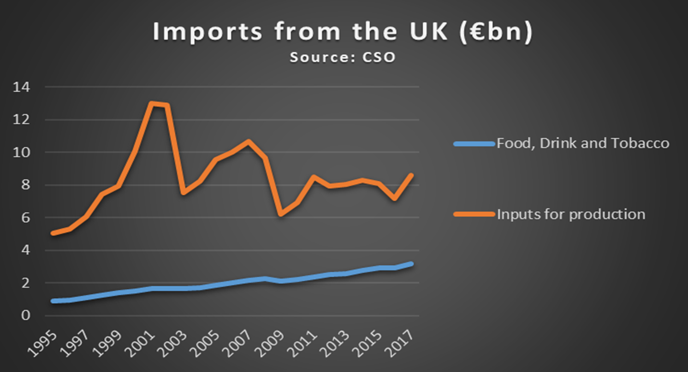
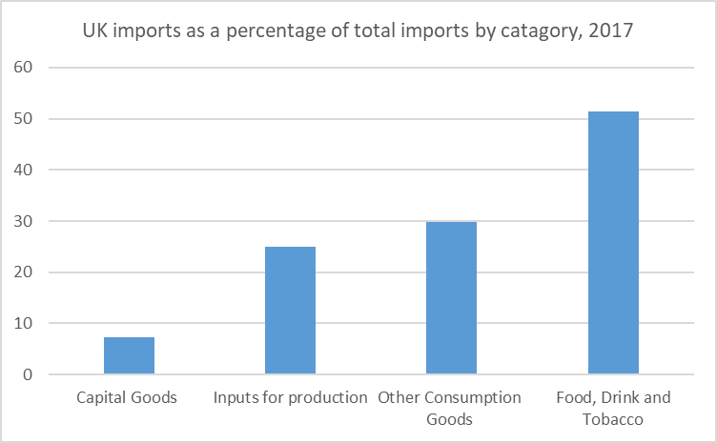
Import risk is under-appreciated

Slide 20
Brexit opportunities

Slide 21
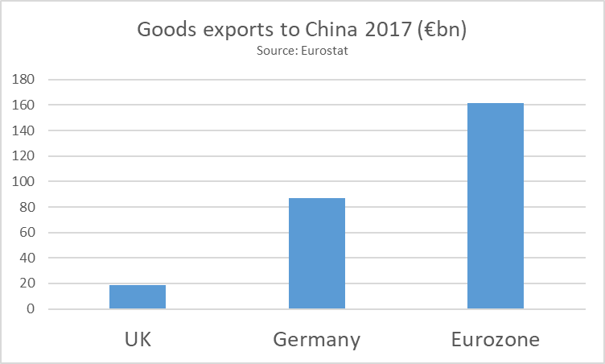
Brexit opportunities for Britain
?

Slide 22
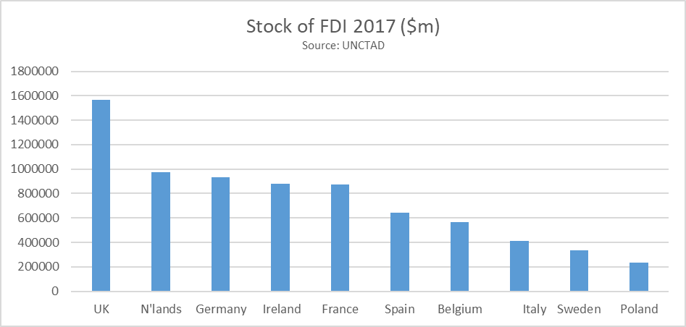
Brexit opportunities for others
UK has the largest stock of FDI in the EU

Slide 23
Thank you.
dan.obrien@iiea.com
Twitter @danobrien20

