Slide 1
Brexit
The Particular Concerns of
Local Authorities
Seamus Neely, Chief Executive
Donegal County Council
4th December 2018

Slide 2
Overview
Introduction
Context
Experience from a North West Perspective
Key Issues
Mitigations
Closing Remarks

Slide 3
Context
Implications for Jurisdictions as a whole
Implications at Regional Level
Implications at the Local Level
Implications at the level of individual organisations
Implications for individuals

Slide 4
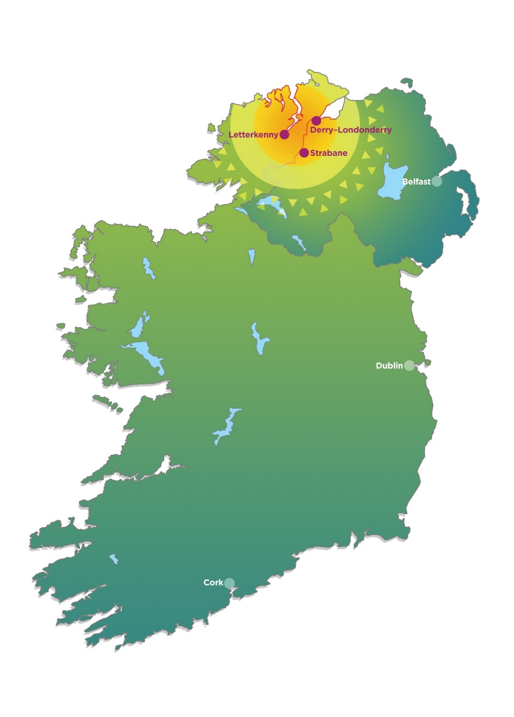
North West City Region
Meeting the needs of 350,000 people in the context of change

Slide 5
North West City Region
Largely the functional areas of Donegal County Council and Derry City & Strabane District Council
Structures :
North West Regional Development Group
North West Strategic Growth Partnership
North West Regional Development Group – Elected members from both Councils.
North West Strategic Growth Partnership – Senior government officials from both sides of the border
Both structures are led jointly by the two Councils.

Slide 6
North West City Region Economy
15,000 businesses active in the North West City region in 2014. Agriculture accounts for 30%, others include retail, hospitality/accommodation and construction.
90% of businesses are ‘micro’.
In Donegal, share of total employment in large enterprises (>250) is much smaller than national average – circa 10% as opposed to 34%
Brexit will not be merely a cause of problems,
but will highlight needs that already exist

Slide 7
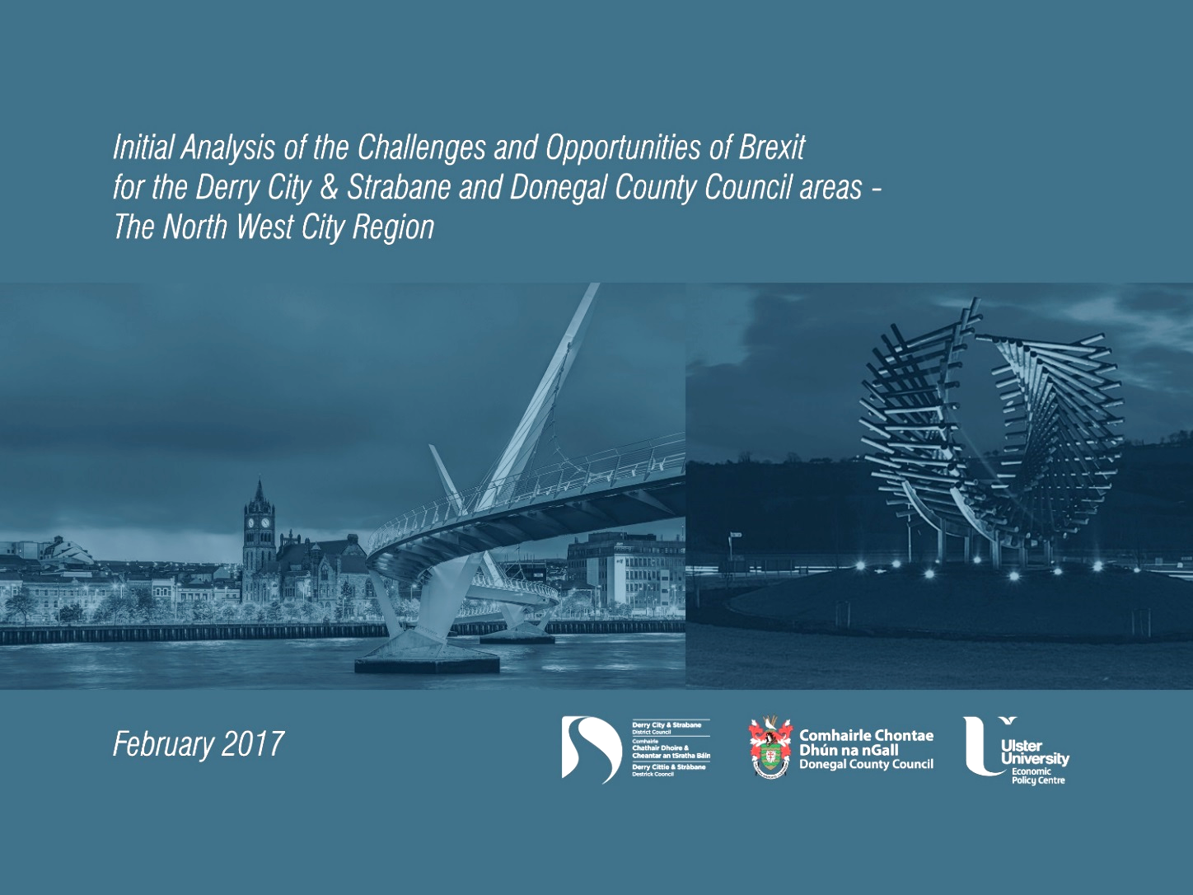

Slide 8
Scoping Study Team – Stage 1
Research Unit DCC
Statistical Support Team DCSDC
Ulster University Economic Policy Centre
Queen’s University Belfast – Social Science
Trinity College Dublin – Department of Economics

Slide 9
Areas where Brexit will impact
BREXIT
Trade
Agri and Fisheries Sectors
Consumer spending and shopping
Investment (inward and existing)
Migration (cross-border and inward)
Funding (various EU streams)
Tourism

Slide 10
People: Commuting patterns: Republic of Ireland inward to Northern Ireland
Origin of RoI commuter
Destination of RoI commuter
All Ireland Research Observatory, Census 2011 data

Slide 11
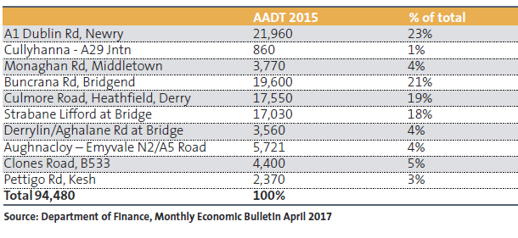
People:
Annual Average Daily Traffic Flows (AADT),
Northern Ireland Border Roads, 2015

Slide 12
Communicating and Listening:
Stakeholder Consultation
North and South
Agriculture/Fishing/Aquaculture
Construction
Manufacturing
Retail
Traded Services
Tourism/Culture/Accommodation
Banking
Logistics

Slide 13
Outputs
Some of what was said
and /or Queried ......

Slide 14
Education
Ability to access R+D funding/partners
Replacement of existing EU funding post 2020
Existing staff mobility – cross border workers
Student mobility – qualifications harmonisation – student loans NI –

Slide 15
Health
Existing initiatives in health potentially constrained – implications for further collaboration
Existing staff mobility – cross border workers
Access to locum staff/recruitment of nurses NI
Access to health services by cross-border workers

Slide 16
Tourism / Culture / Accommodation
While there have been increased rates of growth both North and South – high dependence on home markets results in extreme sensitivity
Any perception that access is difficult through NI needs to be eliminated
- Restrictions on labour mobility would impact on region

Slide 17
Manufacturing
Implications of Divergence in standards over time
Staff mobility non- EU staff traversing NI
Tariffs/Bureaucracy/eForms
Cross-border trade zone
Special Economic status NI/RoI –
Common Trade Area
Alignment of procurement

Slide 18
Construction NI
EU Funding
Access to single market critical
Reduction in EU regulation
Joint ventures – less likely
Skills shortage – labour
Relaxation of procurement

Slide 19
Traded Services
Whether there be a requirement on legal firms who presently export their services into RoI/EU to have a legal presence in RoI?
Implications for cost if that is the case

Slide 20
Retailing
The last decade in retailing has been full of ups and downs…
Periodically as the exchange rate fluctuates we see an upsurge in shoppers one way or the other…..
The uncertainty associated with Brexit delays investment as potential investors cannot be sure of a return…. this is particularly the case on the border….even short term planning is difficult.

Slide 21
Agriculture
“The Dairy industry has been under severe pressure already as the price fell in the last year… the whole industry has changed with the majority of milk in NI exported for processing to the Republic of Ireland.
I don’t think those people suggesting border controls understand, at all, the numerous crossings that there are between ROI and NI. Many farms now cross the border owning buildings and fields on both sides, how will that work? Much of the beef that is produced here goes direct to England for processing, where will the NI processors get their beef from or their workers if they introduce border controls or quotas or tariffs? We are already suffering rural depopulation…. We will be more isolated and worse off…”

Slide 22
Logistics
“Any border controls will impose additional costs on us as carriers that we will have to pass on to our customers. Dozens of lorries travel through Bridgend to the Lisahally Port every day and others to Belfast for one contract. If controls are introduced then the quickest time to process required documentation for such movements would be ten minutes and that would be exceptional...it could take half a day…
For 60,000 tonnes that would involve 2,400 truck movements and at the record clearance time of ten minutes that would equate to 400 hrs… for a driver that would result in 40 non productive days costing about 24,000 euro loss of earnings for the truck. This should give some idea of the risks involved to business…..”

Slide 23
Funding
Interreg
PEACE Programmes
Territorial Co-operation

Slide 24
Key Issues
Movement of People – Travel & Work
Movement of Goods
Customs / Excise arrangements?
Physical Border Arrangements
Trading Arrangements
Transferability of Qualifications
Transferability of Compliance / Regulation
Transferability of Financial / Insurance
General Regulatory Issues

Slide 25
Mitigating Measures
No Economic Border
Free movement of people, goods and services
Future Territorial Co-operation Programmes
Articulation of Further Education & 3rd Level Courses

Slide 26
Closing remarks...

Slide 27
Brexit
The Particular Concerns of
Local Authorities
Seamus Neely, Chief Executive
Donegal County Council
4th December 2018

